Slide 1

Indian Trade Data Analysis
by Akarsh Somani(162) and Gaurav Misra(172)
under the supervision of Dr. Dalia Nandi

Slide 2
About Data-Set
Yearly Data
Data Source - Kaggle.
Data available ranges between 2010 to 2018.
The trade amount is represented in million US $.
Data includes HS Code, Commodity, Value, Country and Year.
Monthly Data
Data source - Department of Commerce website.
Data available ranges between Jan, 2006 to Sept, 2019.
The trade amount is represented in million US $.
Data includes the total amount of trade in a month.

Slide 3
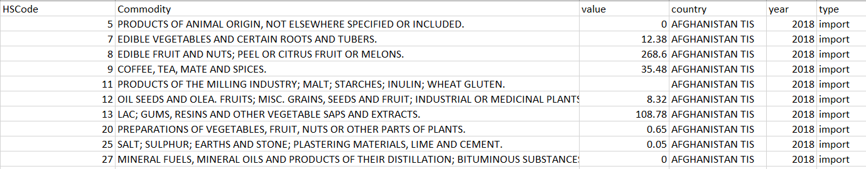
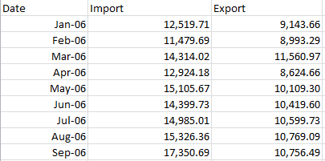
How the data looks

Slide 4
Yearly Data Insights
Can we draw some useful insights by performing various data analytics techniques

Slide 5
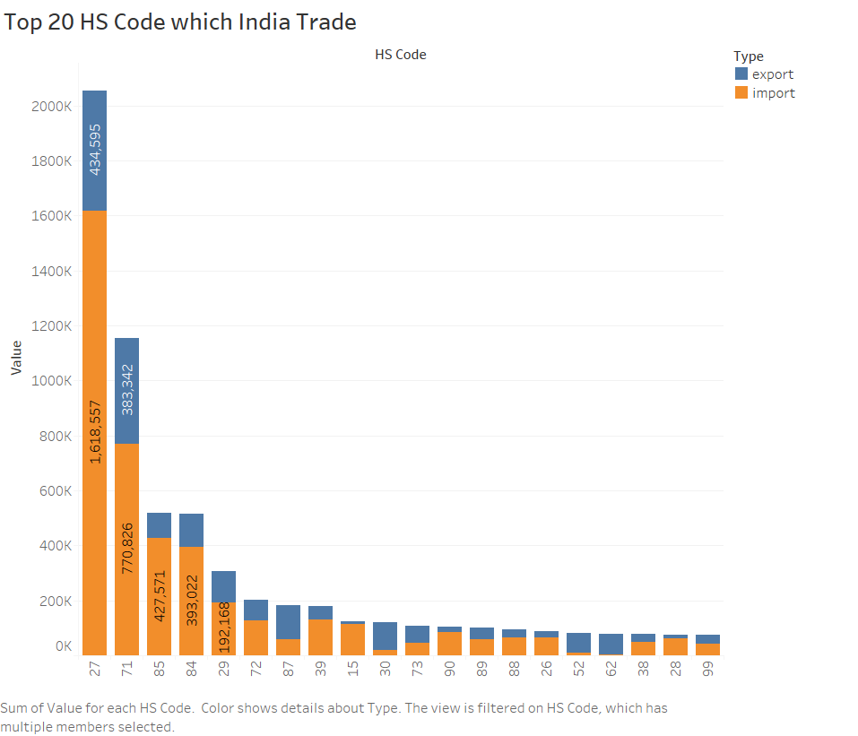
Plots and inferences
27 - Mineral Fuels, Mineral Oils And Products Of Their Distillation; Bituminous Substances; Mineral Waxes
71 - Natural Or Cultured Pearls, Precious Or Semiprecious Stones, pre. Metals, Clad With Pre. Metal And Articles. Jewelry; Coin.
85 - Electrical Machinery And Equipment And Parts Thereof; Sound Recorders And Reproducers, Television Image And Sound Recorders And Reproducers, and Parts.
84 - Nuclear Reactors, Boilers, Machinery And Mechanical Appliances; Parts Thereof.

Slide 6
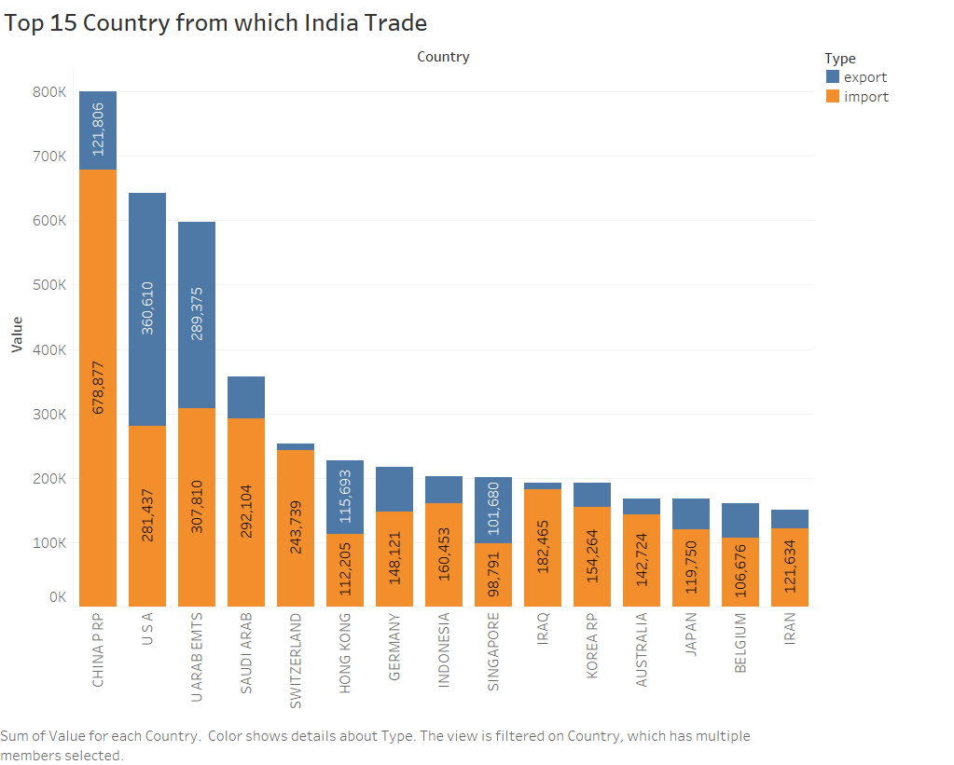
Plots and inferences
Maximum import is from China and the Maximum export is to U.S.A.

Slide 7
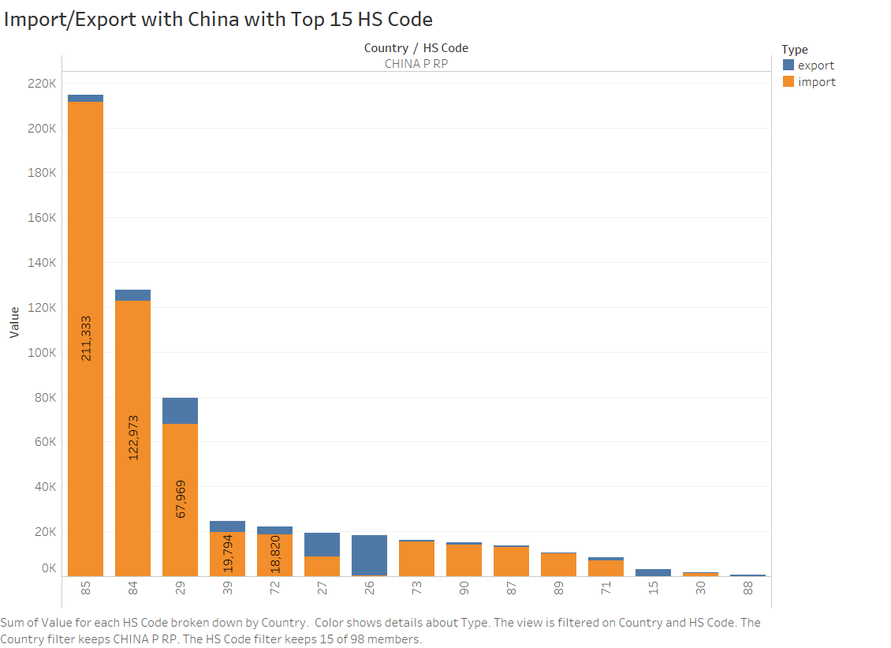
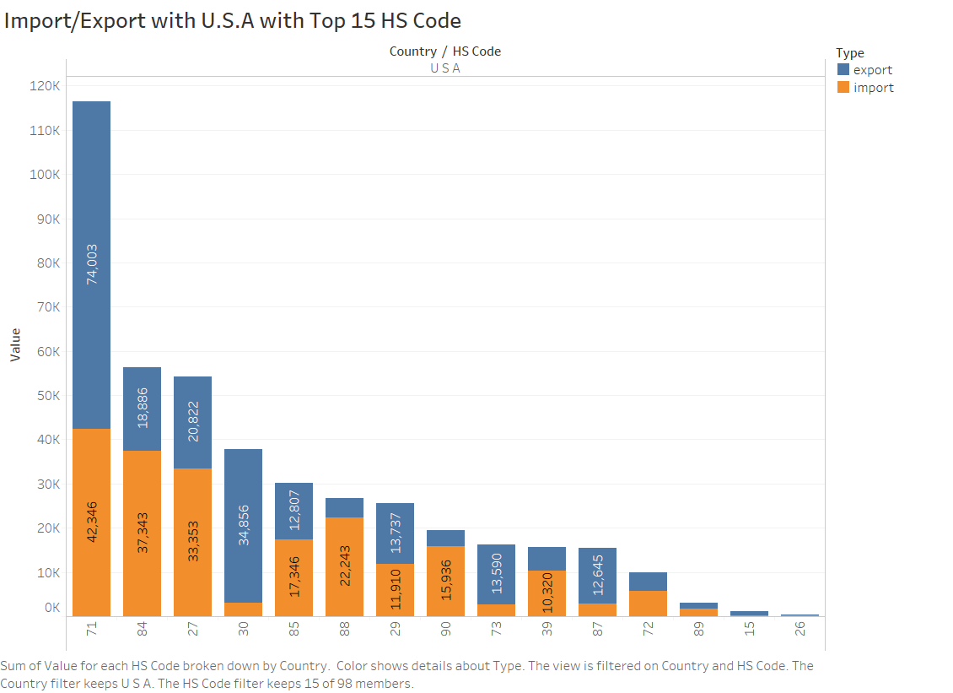
India’s Trade with China and U.S.A

Slide 8
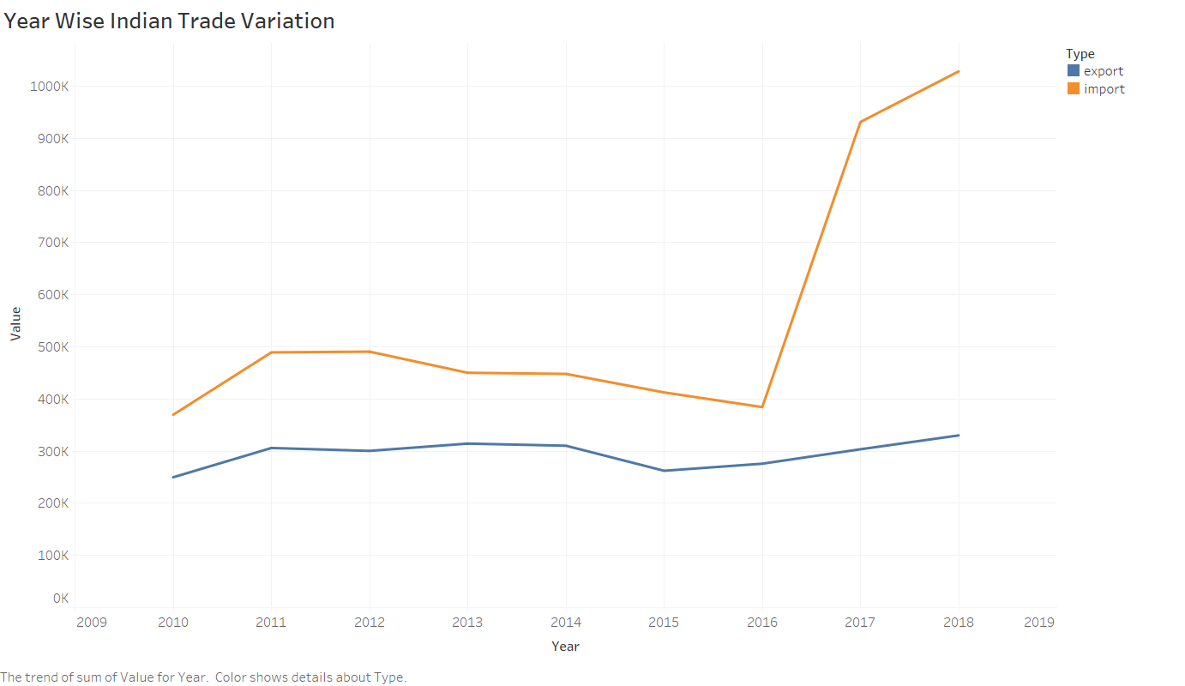
Plots and Inferences
We can see a Bump in Import from year 2016-2017.
That year GST came in picture and the custom duty was revised.

Slide 9
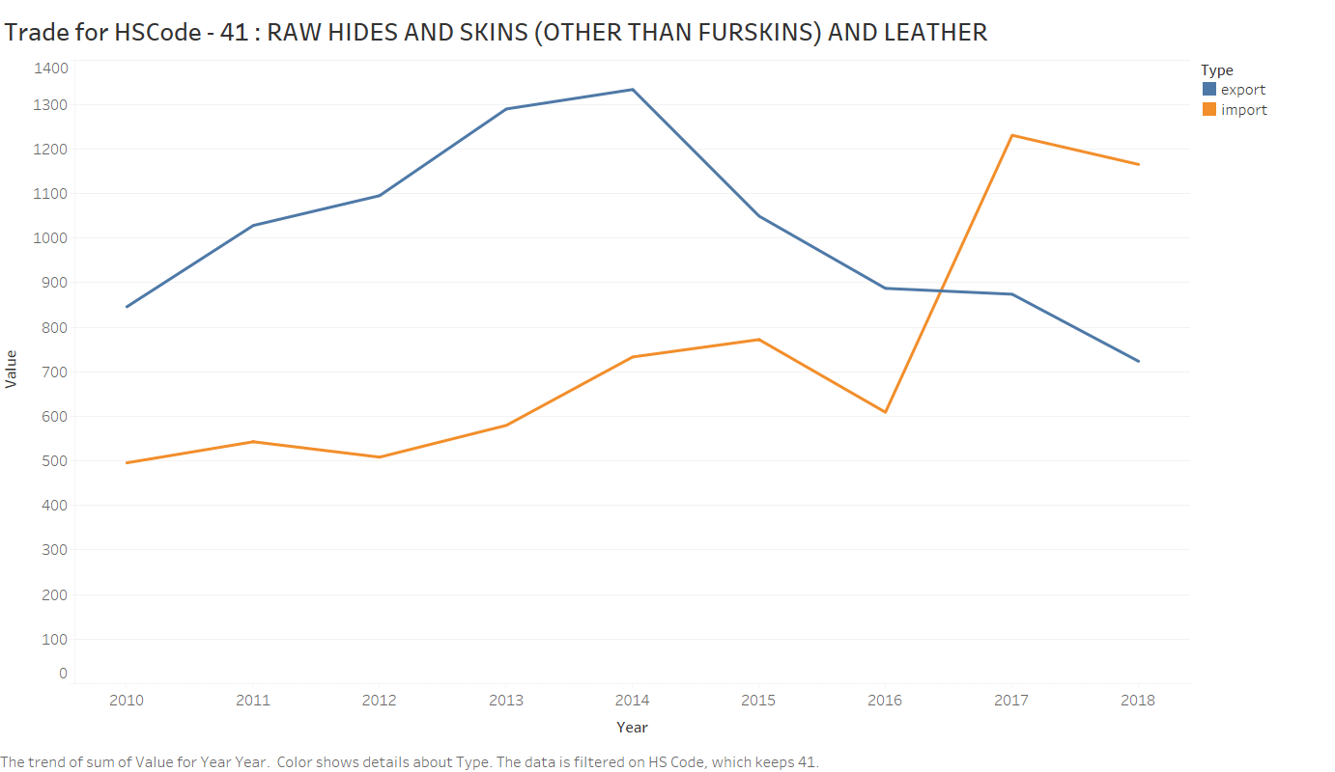
India’s export on skins, hides and leather is decreasing.
India’s Leather Exports Decline, As Cow-Related Violence Increases.
Export growth slowed to 9.37% in 2014-15 and declined more than 19 percentage points in 2015-16, the data show.
- by Indiaspend_{[1]}

Slide 10
Indian trade on Silk(HS Code - 50)
Currently, any import of silk fabrics from Vietnam attracts zero per cent duty, which makes India’s silk fabrics expensive. This has significantly affected the domestic market of India.
Bharat Gandhi, Chairman, The Federation of Indian Art Silk Weaving Industry, averred that the phenomenal rise in the import of silk fabrics from Vietnam in last 2 years has deteriorated the conditions of silk fabric manufacturers hailing from Indian cities of Bhagalpur, Varanasi, Bengaluru, Surat and some parts of Tamil Nadu._{[2]}

Slide 11


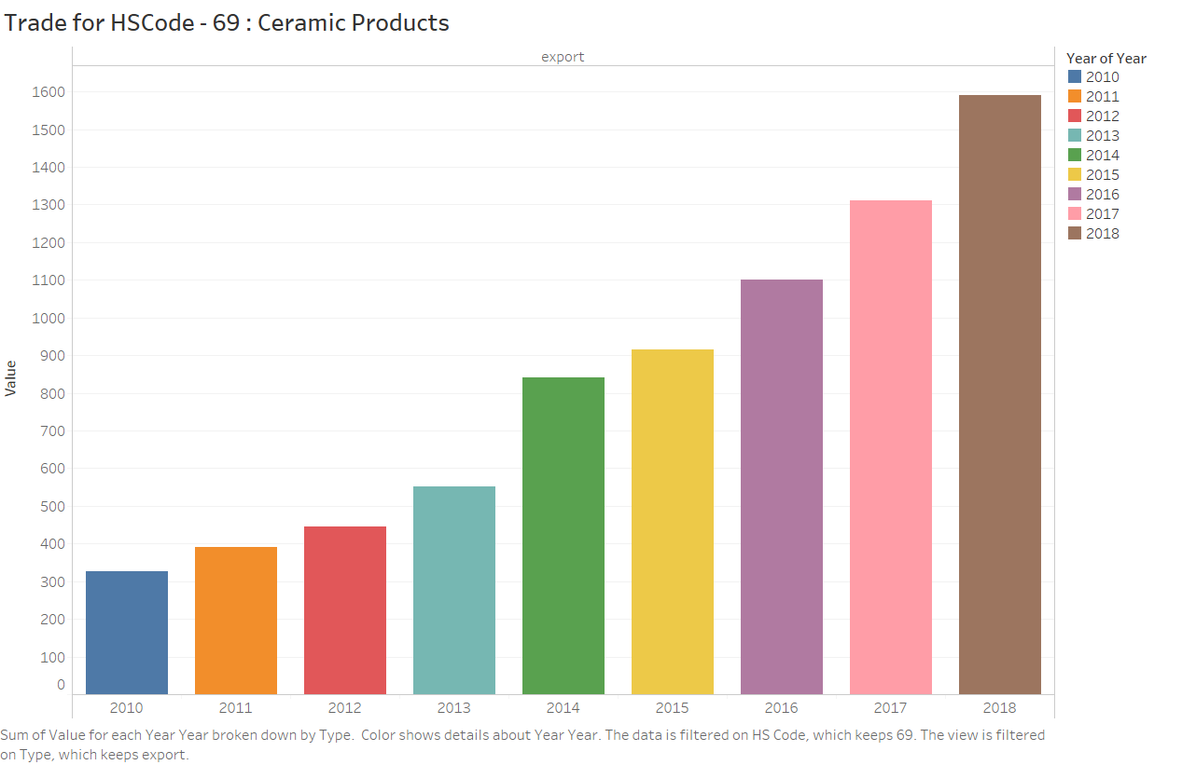
Indian export on Ceramic Products.
During 2017, India was the 24th largest ceramic trading nation in the world and accounted for a share of around 0.9% in total ceramics trade. During the period, from 2010 to 2017, India’s ceramics trade increased from US $836.8 million to US $1.8 billion at a CAGR of 10.07%.
-By CATR, (Centre for Advance Trade Research) | August 29, 2018[3]

Slide 12
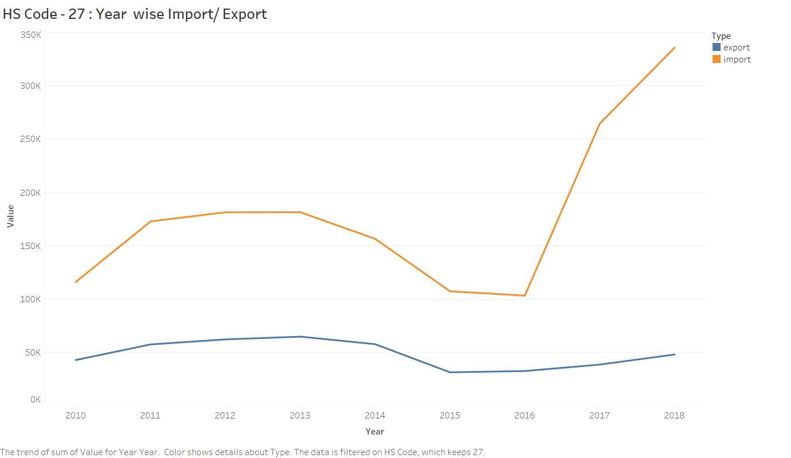
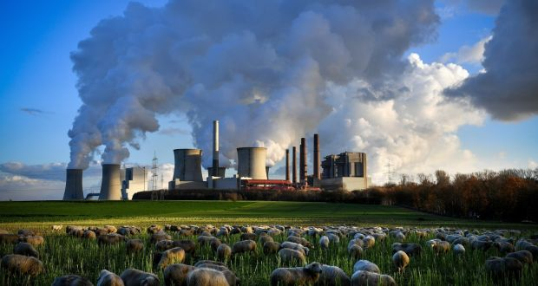
Import/Export of HS Code 27– MINERAL FUELS, MINERAL OILS AND PRODUCTS OF THEIR DISTILLATION; BITUMINOUS SUBSTANCES; MINERAL WAXES.
Petroleum and crude oil imports continued to inflate India’s import bill, rising 42.64% from last year to $11.65 billion.
-Feb 16, 2018, India Times_{[4]}

Slide 13
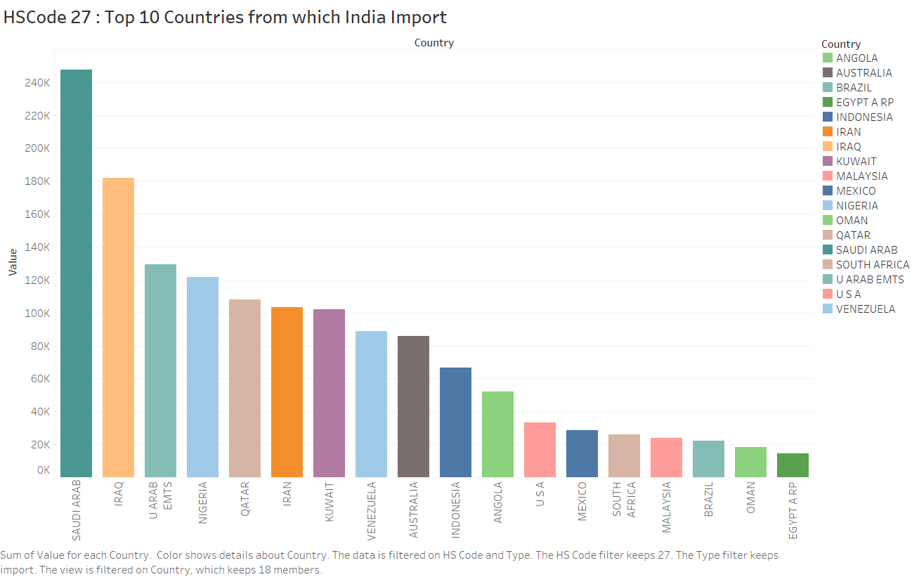
Top Countries From which Mineral products are Imported.

Slide 14
Forecasting on Monthly Data
Can we find some pattern in our data to predict what could be total trade amount of next month?

Slide 15
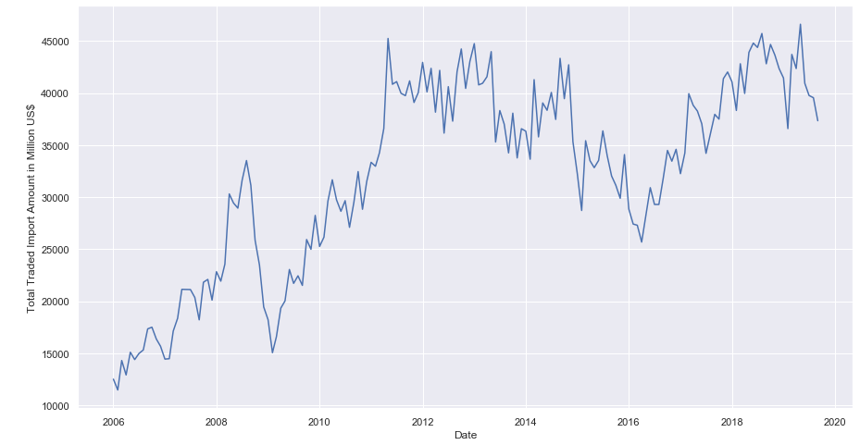
Can we see pattern by just visualizing it?

Slide 16
How to Forecast Trade Amount for Next Month?
Using Moving Average Model
Using ARIMA (Auto Regressive Integrated Moving Average Model)
Using CNN (Convolutional Neural Networks) models
Using RNN (Recurrent Neural Networks) models
Using LSTM (Long Short Term Memory) models, which are basically a modifications over RNNs

Slide 17
LSTMs are the way to go, why?
Moving Average models may perform moderately in short term forecasting but are not reliable since there’s no weightage of past values taken.
ARIMA method is appropriate only for a time series that is stationary.
CNNs are inappropriate for sequential data as they can’t use past values to make predictions.
RNNs are used for processing sequential data but perform badly in case of long-term dependency, this happens because of vanishing gradient problem.
LSTMs store past information and know what to forget and what not to forget which is a modification over RNNs.

Slide 18

Long Short Term Memory (LSTM)
Special kind of RNN, capable of learning long-term dependencies.
Remembering information for long periods of time is practically their default behaviour.
There are three different gates that regulate information flow in an LSTM cell. A forget gate, input gate, and output gate.

Slide 19
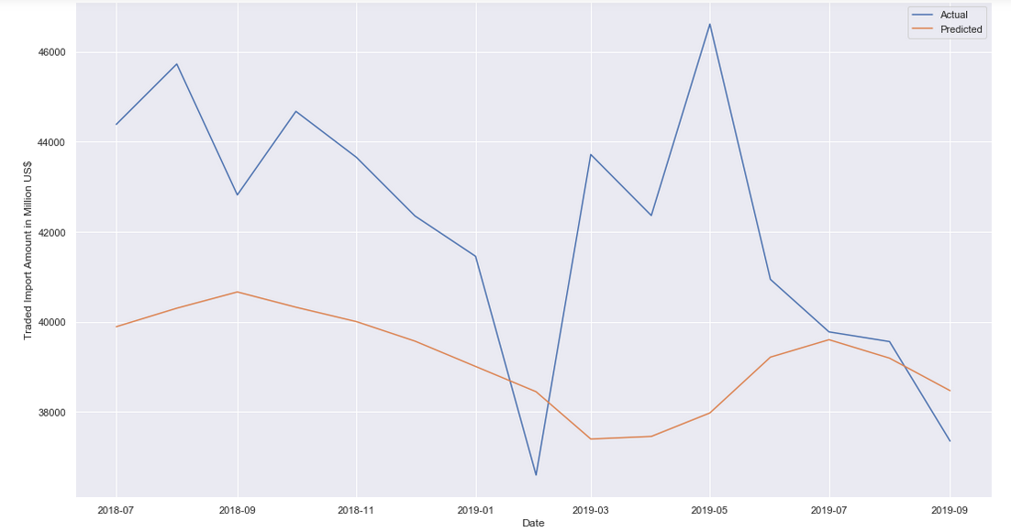
Forecasting Results

Slide 20
Key Takeaways from the Forecasting Curve
The mean of Error in forecasting is 3363.970323 and standard deviation is 2352.545462.
To get more accurate forecasting we should fine tune our model’s parameter in a better way.
We can also modify our model’s network structure.
The brighter side is that our model is able to forecast right trend of trade import amount.
As we have only 165 data points (150 training + 15 validation), it’s too much to ask for a very high accuracy.
More data points will improve our model’s accuracy.

Slide 21
Future To-Do’s
Going Back to data and searching all kind of patterns.
Finding any major country impacting our import/export.
Drawing more insights about trade.
Collecting more data points.
Forecasting on export data.
Forecasting for trade with specific HS-code or country.
Fine tune existing model.

Slide 22
References -
[1] - https://www.indiaspend.com/indias-leather-exports-decline-as-cow-related-violence-increases-99395/
[2] - https://apparelresources.com/business-news/sourcing/increase-import-silk-fabrics-vietnam-big-threat-india/
[3] - https://www.tpci.in/blogs/product-profile-ceramics/
[4] - https://economictimes.indiatimes.com/news/economy/indicators/indias-exports-fall-in-january-so-do-imports/articleshow/62934403.cms?from=mdr&utm_source=contentofinterest&utm_medium=text&utm_campaign=cppst
Image Source - https://www.investopedia.com/terms/t/trade.asp
https://retail.regionaldirectory.us/ceramic-studios-and-products/
https://www.ar.hwaiat.com/Products.aspx?CID=249&&new022d261d-a6c1-479b-9c72-21e922357299
https://www.irishtimes.com/news/environment/increasing-fossil-fuel-use-push-carbon-emissions-to-record-high-1.3721474
https://colah.github.io/posts/2015-08-Understanding-LSTMs/

Slide 23
Thank You!
Hold tight, we’re coding!!!

